Slide 1


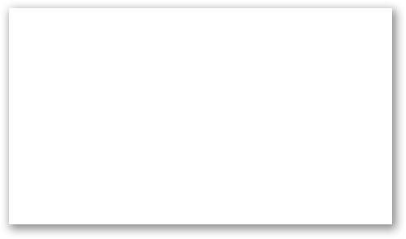

Python

Slide 2


Machine Learning - Standard Deviation
What is Standard Deviation?
Standard deviation is a number that describes how spread out the values are.
A low standard deviation means that most of the numbers are close to the mean (average) value.
A high standard deviation means that the values are spread out over a wider range.

Slide 3


Machine Learning - Standard Deviation
Example: This time we have registered the speed of 7 cars:
The standard deviation is:

Slide 4


Machine Learning - Standard Deviation
Meaning that most of the values are within the range of 0.9 from the mean value, which is 86.4.
Let us do the same with a selection of numbers with a wider range:
The standard deviation is:

Slide 5
Machine Learning - Standard Deviation
Meaning that most of the values are within the range of 37.85 from the mean value, which is 77.4.
As you can see, a higher standard deviation indicates that the values are spread out over a wider range.
The NumPy module has a method to calculate the standard deviation:

